Slide 1
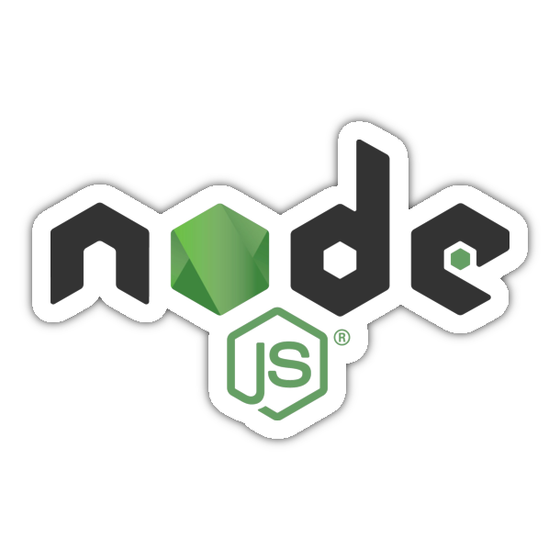

Slide 2
What is Node.js ?
Node.js is a powerful, open-source, cross-platform JavaScript runtime environment that allows developers to run JavaScript code outside of a web browser.
Node.js enables server-side scripting and is commonly used to build scalable network applications, particularly web servers.
One of the key features of Node.js is its event-driven, non-blocking I/O model, which allows it to handle many concurrent connections efficiently. This makes it well-suited for building applications that require high throughput and real-time data exchange.

Slide 3
What Can Node.js Do?
Node.js can generate dynamic page content
Node.js can create, open, read, write, delete, and close files on the server
Node.js can collect form data
Node.js can add, delete, modify data in your database

Slide 4
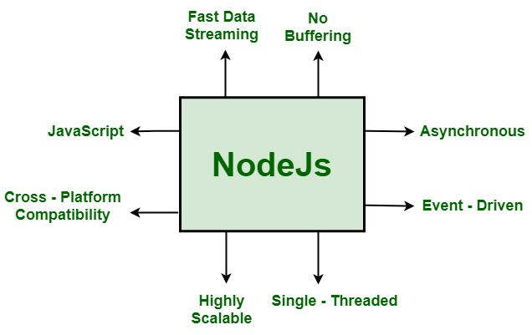
Key Features of Node.js

